Slide 1

ICE4101: Artificial Intelligence RNN
Instructor: M. Shamim Kaiser
Email: shamimkaiser@gmail.com
Cell Phone : 01971932323
Skype: shamimkaiser

Slide 2
Applications
Image captioning
Generating poems after being trained on Shakespeare poem’s
Reading handwriting
Machine translation
Stock prediction
Sequence generation
Voice recognition

Slide 3
Limitation of Feed forward NN
Not designed for sequence/time series data, thus the results are not up to the mark.
Does not mode memory
Example for sequential data: sentences, stock prices, video streams

Slide 4



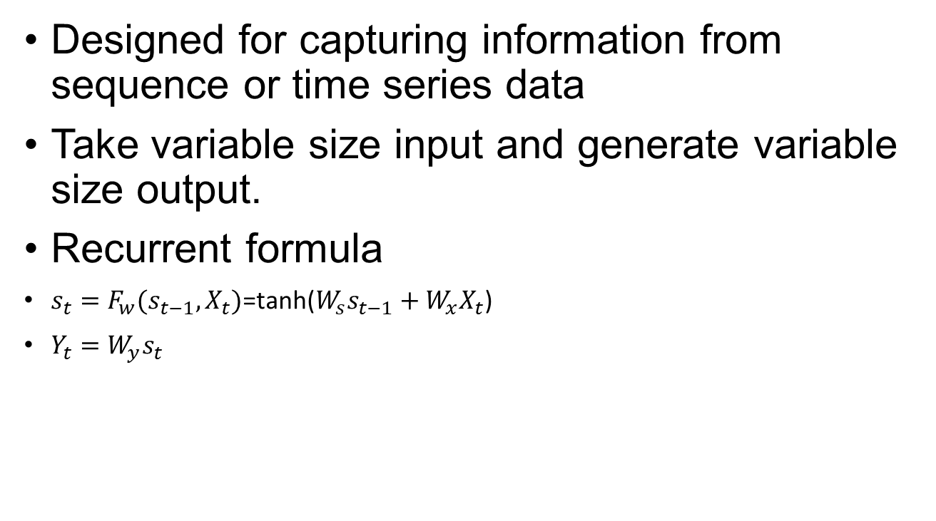




What is RNN?
Designed for capturing information from sequence or time series data
Take variable size input and generate variable size output.
Recurrent formula
$s_{t}=F_{w}(s_{t−1}, X_{t})$=tanh(${W_{s}s}_{t−1}+{W_{x}X}_{t}$)
$Y_{t}={W_{y}s}_{t}$
$$X_{t}$$
$$Y_{t}$$
$$S_{0}$$
$$S_{1}$$
$$W_{x}$$
$$W_{y}$$
$$W_{s}$$

Slide 5
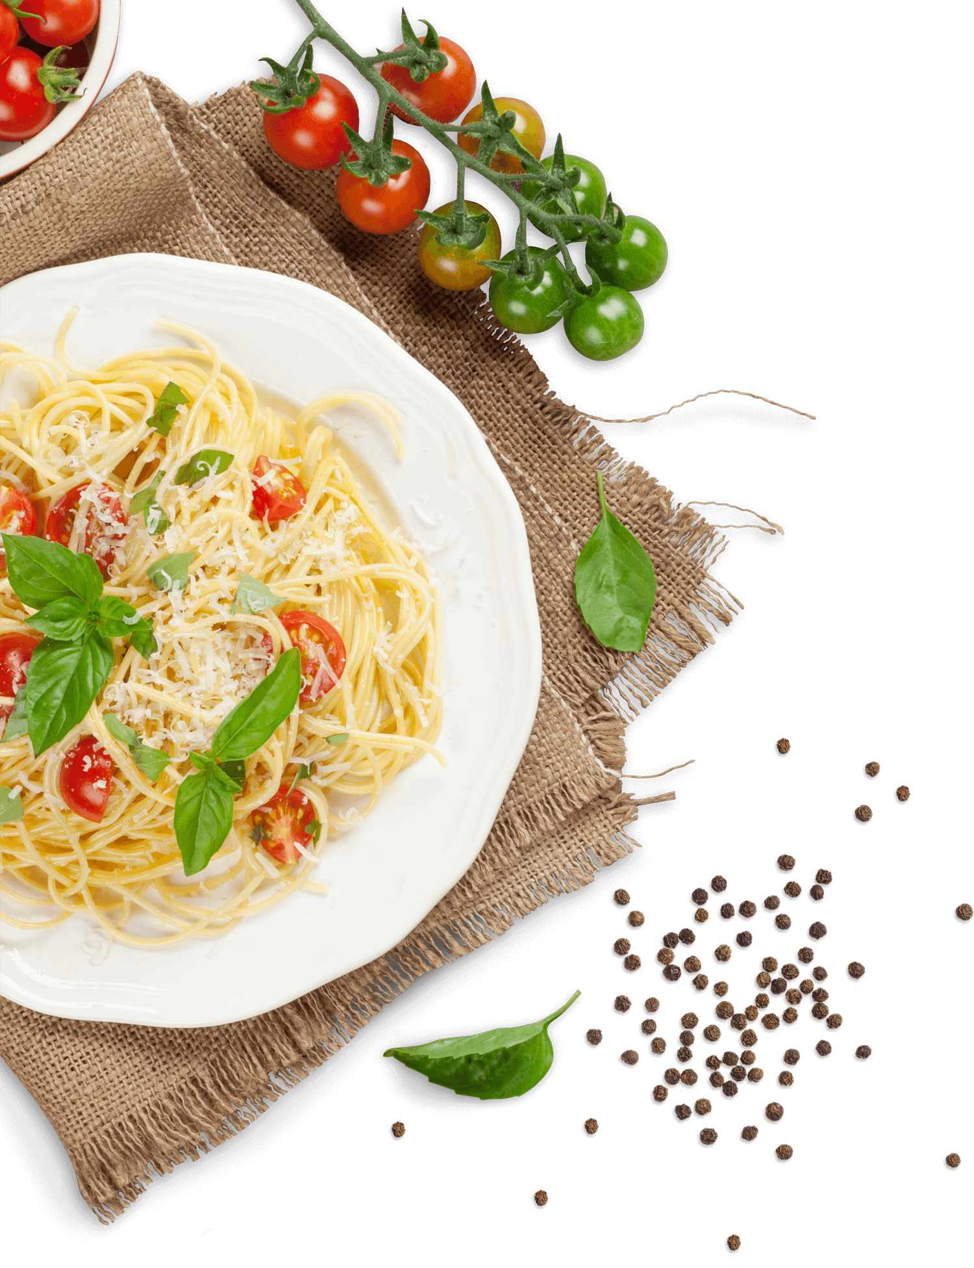
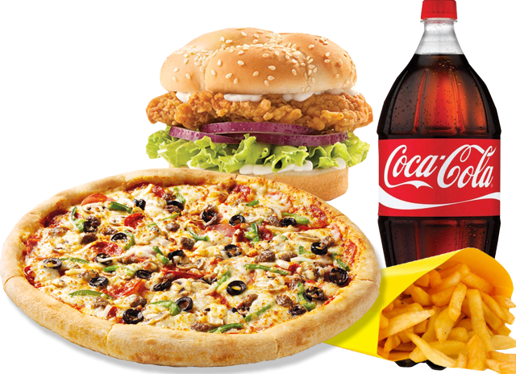
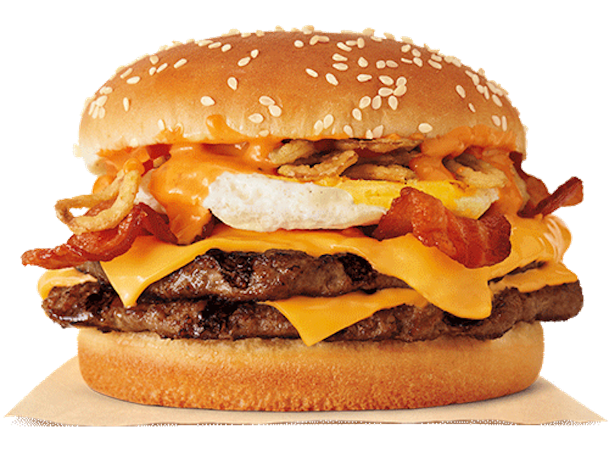







Vectors—3 possible food, weather
$$\left[\begin{matrix}1 \\ 0 \\ 0\end{matrix}\right]$$
$$\left[\begin{matrix}0 \\ 1 \\ 0\end{matrix}\right]$$
$$\left[\begin{matrix}0 \\ 0 \\ 1\end{matrix}\right]$$
$$\left[\begin{matrix}1 \\ 0\end{matrix}\right]$$
$$\left[\begin{matrix}0 \\ 1\end{matrix}\right]$$

Slide 6
NN

Slide 7




NN
$$\left[\begin{matrix}1 \\ 0 \\ 0\end{matrix}\right]$$
$$\left[\begin{matrix}1 \\ 0\end{matrix}\right]$$
$$\left[\begin{matrix}0 \\ 1\end{matrix}\right]$$
$$\left[\begin{matrix}0 \\ 1 \\ 0\end{matrix}\right]$$

Slide 8

NN
$$\left[\begin{matrix}1 \\ 0 \\ 0\end{matrix}\right]$$
$$\left[\begin{matrix}1 \\ 0\end{matrix}\right]$$
$$\left[\begin{matrix}1 & 0 \\ 0 & 1 \\ 0 & 0\end{matrix}\right]$$
$$\left[\begin{matrix}0 \\ 1\end{matrix}\right]$$
$$\left[\begin{matrix}0 \\ 1 \\ 0\end{matrix}\right]$$

Slide 9






Vectors—3 possible food, weather
$$\left[\begin{matrix}1 \\ 0 \\ 0\end{matrix}\right]$$
$$\left[\begin{matrix}0 \\ 1 \\ 0\end{matrix}\right]$$
$$\left[\begin{matrix}0 \\ 0 \\ 1\end{matrix}\right]$$
$$\left[\begin{matrix}1 \\ 0\end{matrix}\right]$$
$$\left[\begin{matrix}1 \\ 0\end{matrix}\right]$$
Sunday Mon Tue Wed Thurs Fri Sat
P N B P N B
$$\left[\begin{matrix}0 \\ 1\end{matrix}\right]$$

Slide 10






RNN
$$\left[\begin{matrix}1 \\ 0 \\ 0\end{matrix}\right]$$
$$\left[\begin{matrix}0 \\ 1 \\ 0\end{matrix}\right]$$
RNN
$$\left[\begin{matrix}0 \\ 1 \\ 0\end{matrix}\right]$$
$$\left[\begin{matrix}0 \\ 0 \\ 1\end{matrix}\right]$$
$$\left[\begin{matrix}0 \\ 0 \\ 1\end{matrix}\right]$$
$$\left[\begin{matrix}1 \\ 0 \\ 0\end{matrix}\right]$$

Slide 11
RNN
$$\left[\begin{matrix}1 \\ 0 \\ 0\end{matrix}\right]$$
$$\left[\begin{matrix}0 \\ 1 \\ 0\end{matrix}\right]$$
RNN
$$\left[\begin{matrix}0 \\ 1 \\ 0\end{matrix}\right]$$
$$\left[\begin{matrix}0 \\ 0 \\ 1\end{matrix}\right]$$
$$\left[\begin{matrix}0 \\ 0 \\ 1\end{matrix}\right]$$
$$\left[\begin{matrix}1 \\ 0 \\ 0\end{matrix}\right]$$

Slide 12
RNN
$$\left[\begin{matrix}1 \\ 0 \\ 0\end{matrix}\right]$$
$$\left[\begin{matrix}0 \\ 1 \\ 0\end{matrix}\right]$$
RNN
$$\left[\begin{matrix}0 \\ 1 \\ 0\end{matrix}\right]$$
$$\left[\begin{matrix}0 \\ 0 \\ 1\end{matrix}\right]$$
$$\left[\begin{matrix}0 \\ 0 \\ 1\end{matrix}\right]$$
$$\left[\begin{matrix}1 \\ 0 \\ 0\end{matrix}\right]$$

Slide 13

RNN
$$\left[\begin{matrix}1 \\ 0 \\ 0\end{matrix}\right]$$
$$\left[\begin{matrix}0 \\ 1 \\ 0\end{matrix}\right]$$
$$\left[\begin{matrix}0 \\ 1 \\ 0\end{matrix}\right]$$
$$\left[\begin{matrix}0 & 0 & 1 \\ 1 & 0 & 0 \\ 0 & 1 & 0\end{matrix}\right]$$
$$\left[\begin{matrix}0 \\ 0 \\ 1\end{matrix}\right]$$
$$\left[\begin{matrix}0 \\ 0 \\ 1\end{matrix}\right]$$
$$\left[\begin{matrix}1 \\ 0 \\ 0\end{matrix}\right]$$

Slide 14

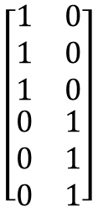

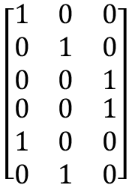



RNN with two input
$$\left[\begin{matrix}1 \\ 0 \\ 0\end{matrix}\right]$$
$$\left[\begin{matrix}0 \\ 1 \\ 0\end{matrix}\right]$$
$$\left[\begin{matrix}0 \\ 0 \\ 1\end{matrix}\right]$$
$$\left[\begin{matrix}1 \\ 0\end{matrix}\right]$$
$$\left[\begin{matrix}0 \\ 1\end{matrix}\right]$$
Sunday Mon Tue Wed Thurs Fri Sat
P P N B B P
Add
$$\left[\begin{aligned}\begin{matrix}1 & 0 & 0 \\ 0 & 1 & 0 \\ 0 & 0 & 1\end{matrix} \\ \begin{matrix}0 & 0 & 1 \\ 1 & 0 & 0 \\ 0 & 1 & 0\end{matrix}\end{aligned}\right]$$
$$\left[\begin{aligned}\begin{matrix}1 & 0 \\ 1 & 0 \\ 1 & 0\end{matrix} \\ \begin{matrix}0 & 1 \\ 0 & 1 \\ 0 & 1\end{matrix}\end{aligned}\right]$$
Cooking Schedule
+
NN
Merge
Food
Weather

Slide 15
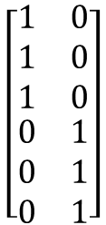
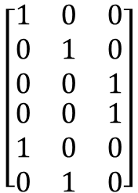




RNN with two input
$$\left[\begin{matrix}1 \\ 0 \\ 0\end{matrix}\right]$$
$$\left[\begin{matrix}0 \\ 1 \\ 0\end{matrix}\right]$$
$$\left[\begin{matrix}0 \\ 0 \\ 1\end{matrix}\right]$$
$$\left[\begin{matrix}1 \\ 0\end{matrix}\right]$$
$$\left[\begin{matrix}0 \\ 1\end{matrix}\right]$$
Food
NN
$$\left[\begin{aligned}\begin{matrix}1 & 0 & 0 \\ 0 & 1 & 0 \\ 0 & 0 & 1\end{matrix} \\ \begin{matrix}0 & 0 & 1 \\ 1 & 0 & 0 \\ 0 & 1 & 0\end{matrix}\end{aligned}\right]$$
$$\left[\begin{aligned}\begin{matrix}1 \\ 0 \\ 0\end{matrix} \\ \begin{matrix}0 \\ 1 \\ 0\end{matrix}\end{aligned}\right]$$
Same
$$\left[\begin{matrix}1 \\ 0 \\ 0\end{matrix}\right]$$
=
Next
$$\left[\begin{aligned}\begin{matrix}1 & 0 \\ 1 & 0 \\ 1 & 0\end{matrix} \\ \begin{matrix}0 & 1 \\ 0 & 1 \\ 0 & 1\end{matrix}\end{aligned}\right]$$
$$\left[\begin{aligned}\begin{matrix}1 \\ 1 \\ 1\end{matrix} \\ \begin{matrix}0 \\ 0 \\ 0\end{matrix}\end{aligned}\right]$$
Same
$$\left[\begin{matrix}1 \\ 0\end{matrix}\right]$$
=
Next

Slide 16
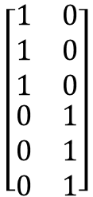
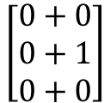





RNN with two input
$$\left[\begin{matrix}1 \\ 0 \\ 0\end{matrix}\right]$$
$$\left[\begin{matrix}0 \\ 1 \\ 0\end{matrix}\right]$$
$$\left[\begin{matrix}0 \\ 0 \\ 1\end{matrix}\right]$$
$$\left[\begin{matrix}1 \\ 0\end{matrix}\right]$$
$$\left[\begin{matrix}0 \\ 1\end{matrix}\right]$$
Food
NN
$$\left[\begin{aligned}\begin{matrix}1 & 0 & 0 \\ 0 & 1 & 0 \\ 0 & 0 & 1\end{matrix} \\ \begin{matrix}0 & 0 & 1 \\ 1 & 0 & 0 \\ 0 & 1 & 0\end{matrix}\end{aligned}\right]$$
$$\left[\begin{aligned}\begin{matrix}1 & 0 \\ 1 & 0 \\ 1 & 0\end{matrix} \\ \begin{matrix}0 & 1 \\ 0 & 1 \\ 0 & 1\end{matrix}\end{aligned}\right]$$
+
Non-linear
$$\left[\begin{aligned}\begin{matrix}1 \\ 0 \\ 0\end{matrix} \\ \begin{matrix}0 \\ 1 \\ 0\end{matrix}\end{aligned}\right]$$
$$\left[\begin{aligned}\begin{matrix}0 \\ 0 \\ 0\end{matrix} \\ \begin{matrix}1 \\ 1 \\ 1\end{matrix}\end{aligned}\right]$$
$$\left[\begin{aligned}\begin{matrix}1 \\ 0 \\ 0\end{matrix} \\ \begin{matrix}1 \\ 2 \\ 1\end{matrix}\end{aligned}\right]$$
$$\left[\begin{aligned}\begin{matrix}0 \\ 0 \\ 0\end{matrix} \\ \begin{matrix}0 \\ 1 \\ 0\end{matrix}\end{aligned}\right]$$
Same
Same
=
$$\left[\begin{matrix}0+0 \\ 0+1 \\ 0+0\end{matrix}\right]$$
$$\left[\begin{matrix}0 \\ 1 \\ 0\end{matrix}\right]$$
+
=
Next
Next

Slide 17


RNN
NN
$$\left[\begin{matrix}1 \\ 0 \\ 0\end{matrix}\right]$$
$$\left[\begin{matrix}0 \\ 1\end{matrix}\right]$$

Slide 18
Training
Use gradient decent

